Slide 1
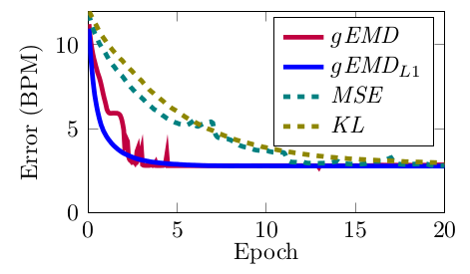
Optimizing Problems with the Wasserstein Loss and the Importance of Choosing the Right Loss Function
Manuel Martinez
manuel.martinez@kit.edu
Computer Vision and Human Interaction Lab
Prof. Rainer Stiefelhagen

Slide 2

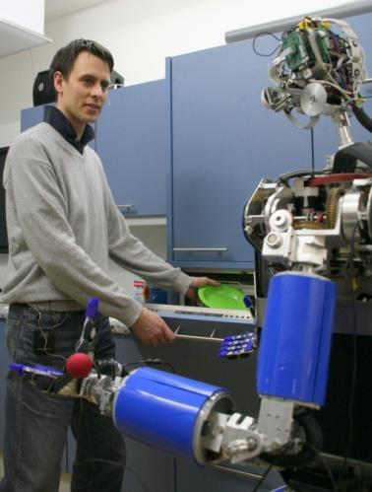
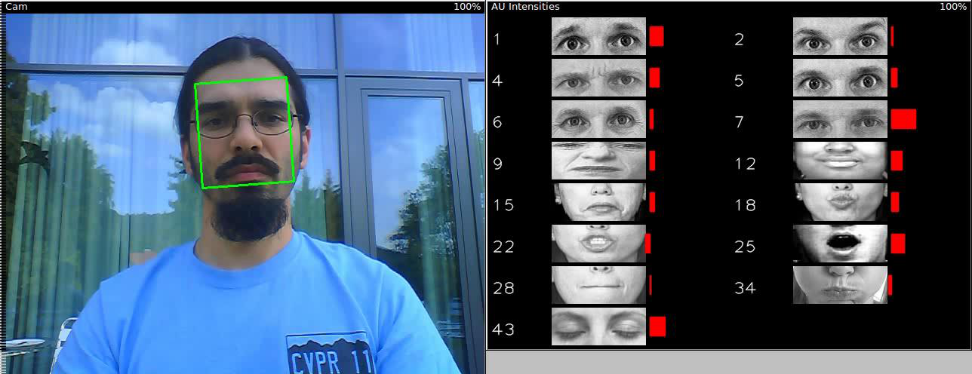
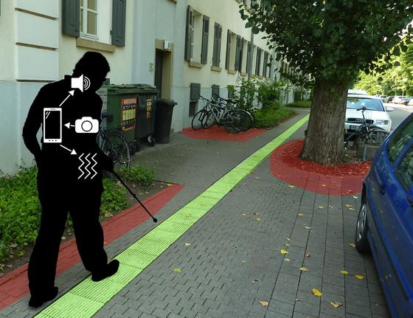
Computer Vision for Human Computer Interaction Prof. Rainer Stiefelhagen

Slide 3
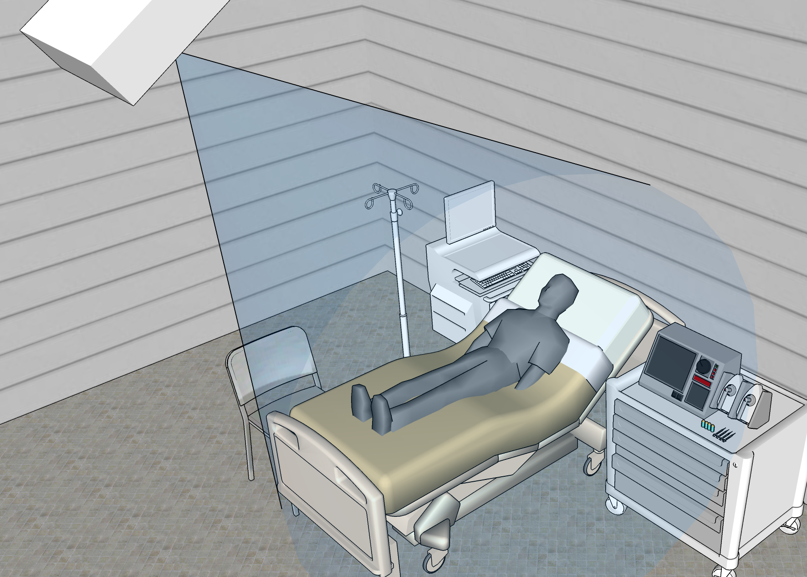
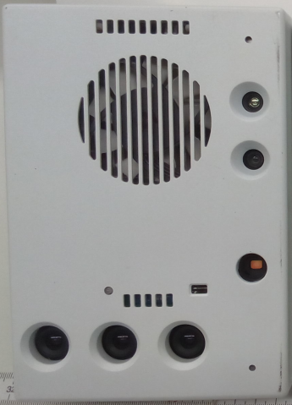
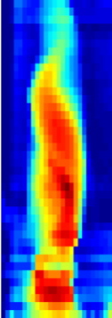
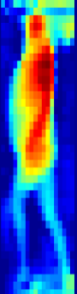
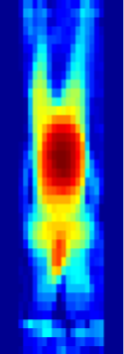
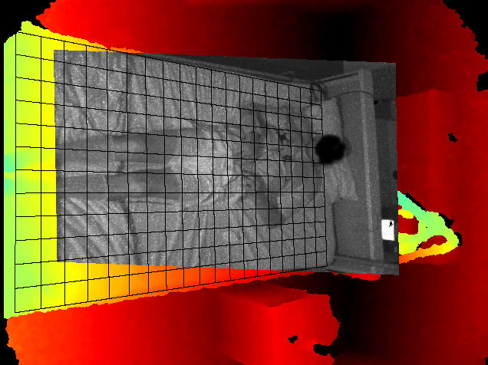
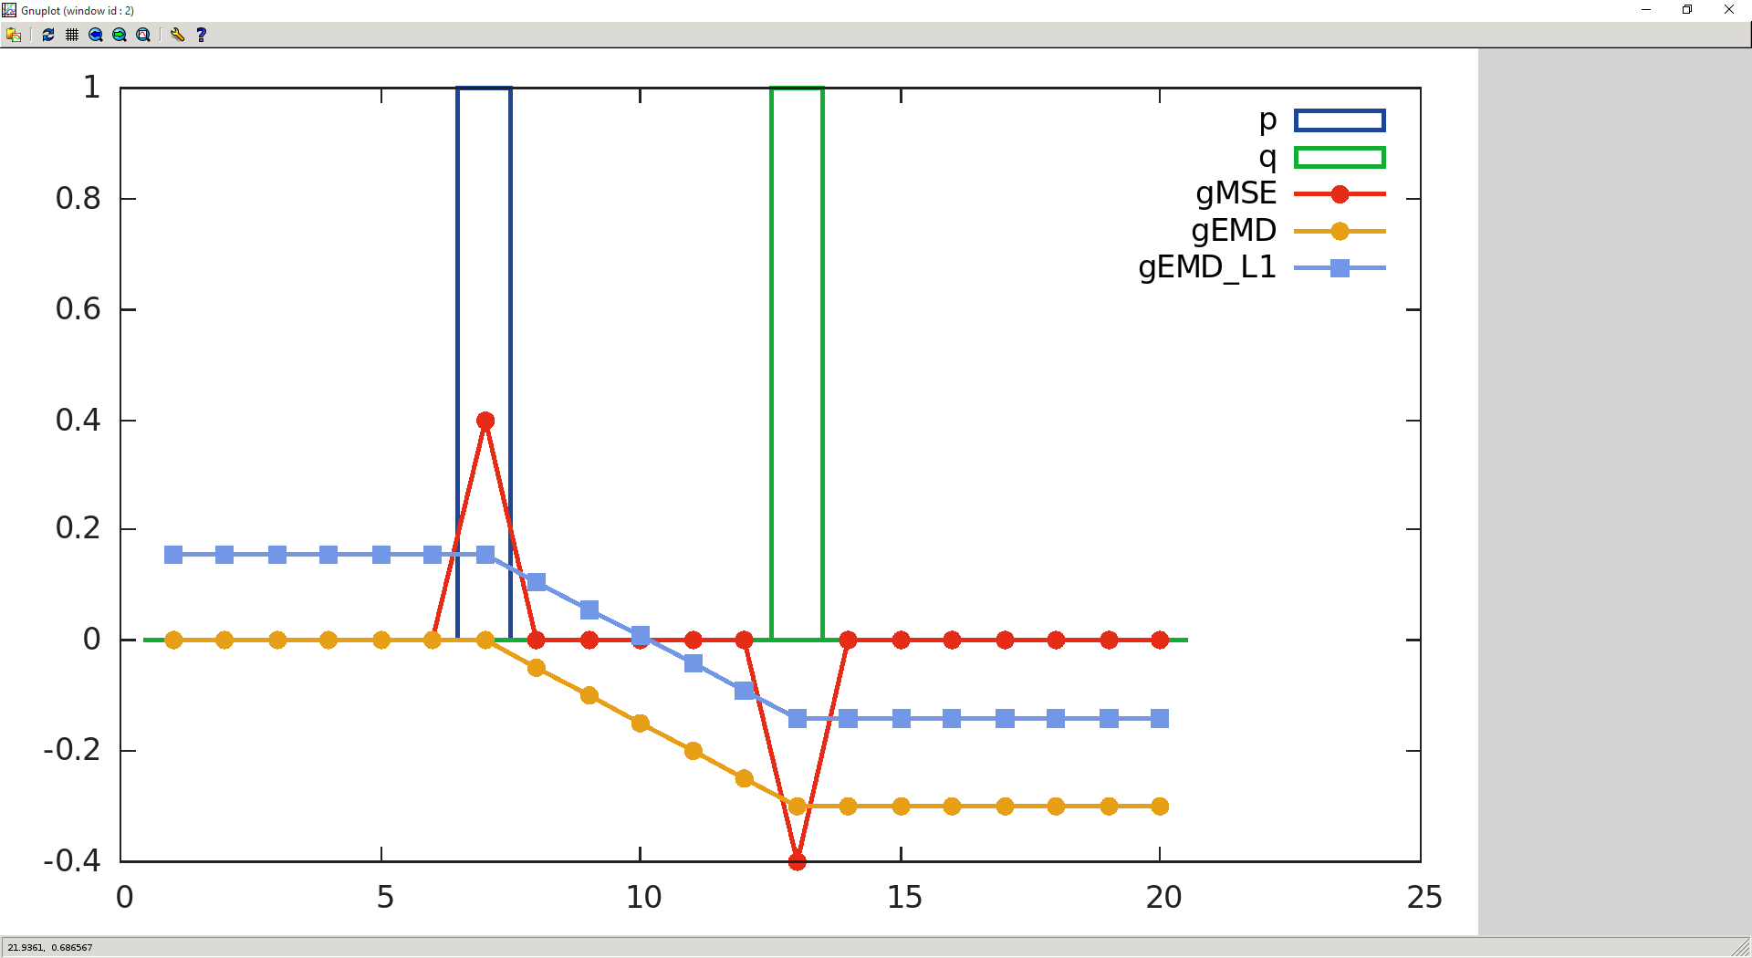
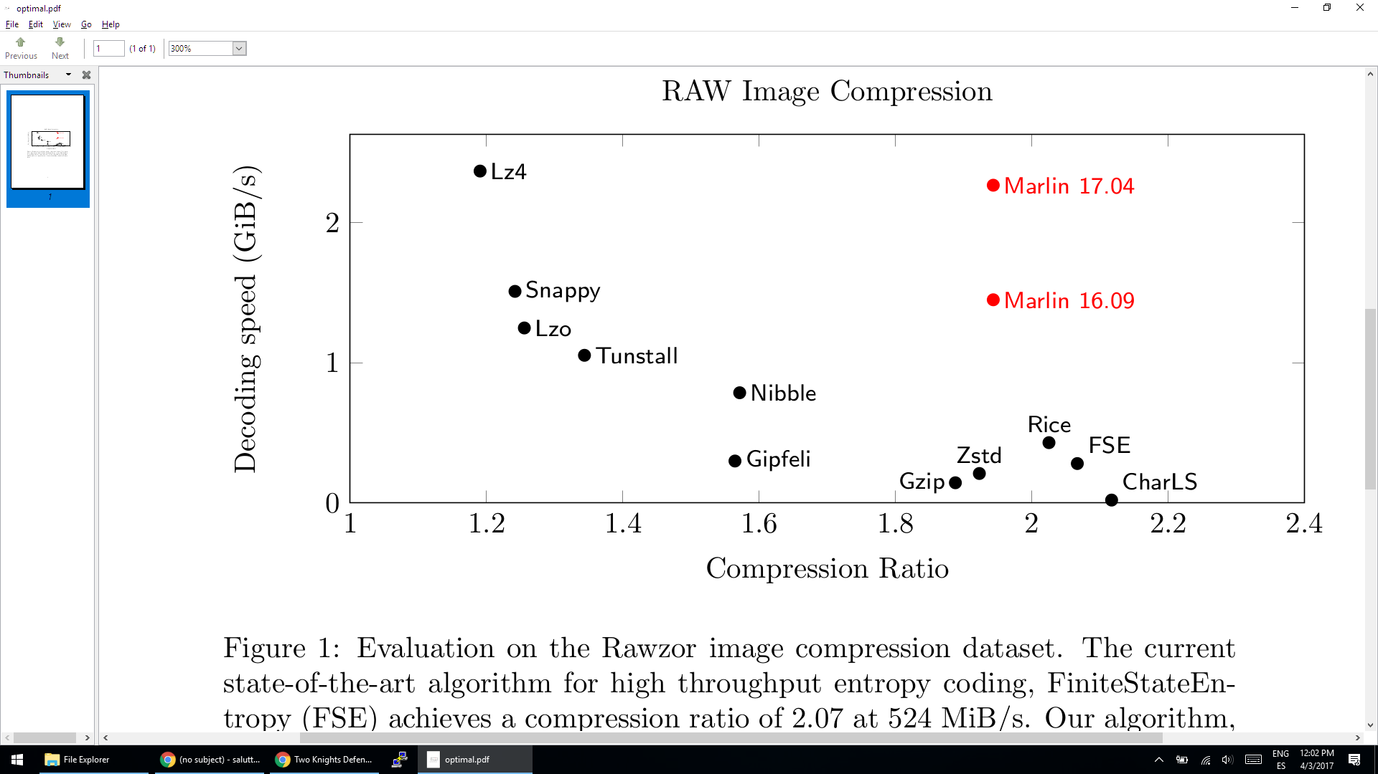
What do I do?

Slide 4
Organization
What is a Loss function (a.k.a. Criterion)
The Wasserstein Distance
Mallow’s Moments
Wasserstein Distance
Earth Mover’s Distance
Not Wasserstein Distance
Sinkhorn Distance
Using the Wasserstein Distance as a Loss
Sinkhorn Distance
Pure Wasserstein Distance
Squared Wasserstein Distance
Examples
Breath Rate Prediction
ImageNet Experiments
Wasserstein GANs
Etc.

Slide 5



What is Machine Learning, Artificial Intelligence, or Pattern Recognition?
TRAINING
ACTUAL USE:
DATA
LABELS
DATA
MODEL
MODEL
PREDICTIONS

Slide 6
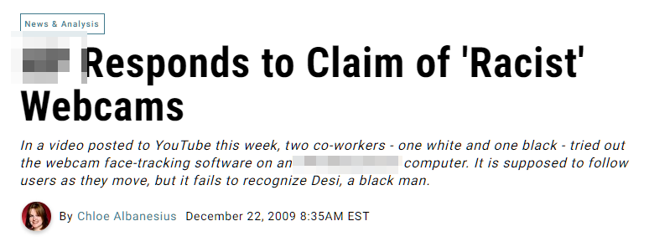
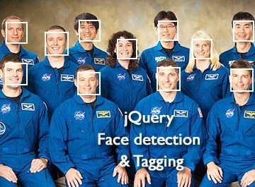
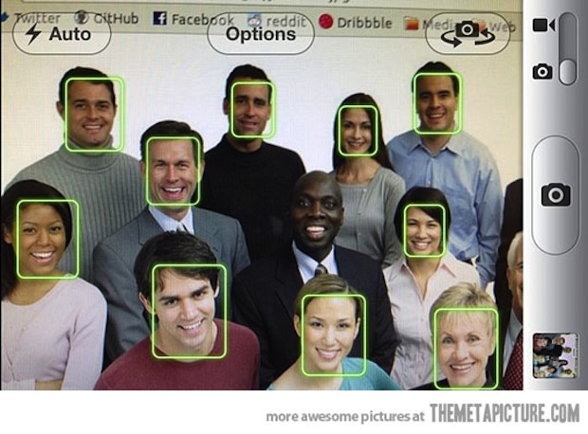
What happens if the data is not good enough?
TRAINING
ACTUAL USE:
DATA
LABELS
DATA
MODEL

Slide 7
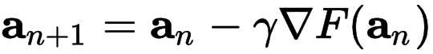
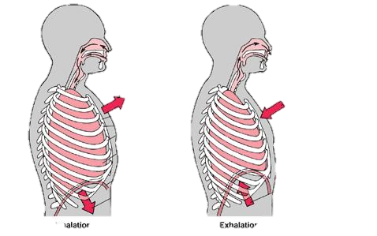
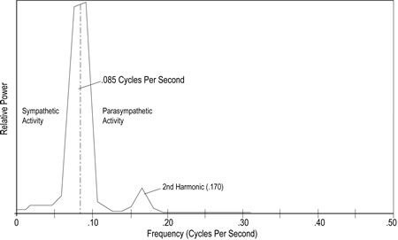
Example time!
DATA
LABELS

Slide 8
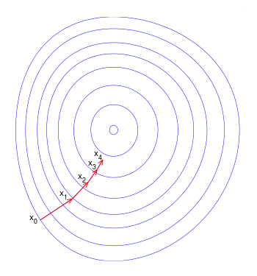
Example time!

Slide 9
Example time!

Slide 10
Example time!

Slide 11
Example time!

Slide 12



Analogy time!
Limited nº of uses!

Slide 13



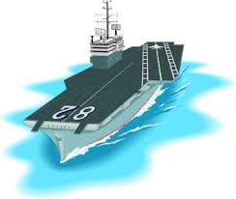
What matters the most.

Slide 14

Analogy time!
$${pos}_{n+1}={pos}_{n}−γ\underset{{pos}_{n}}{∇L}{({pos}_{n}, target)}$$
L: Loss Function (a.k.a) Criterion
Limited nº of uses!

Slide 15
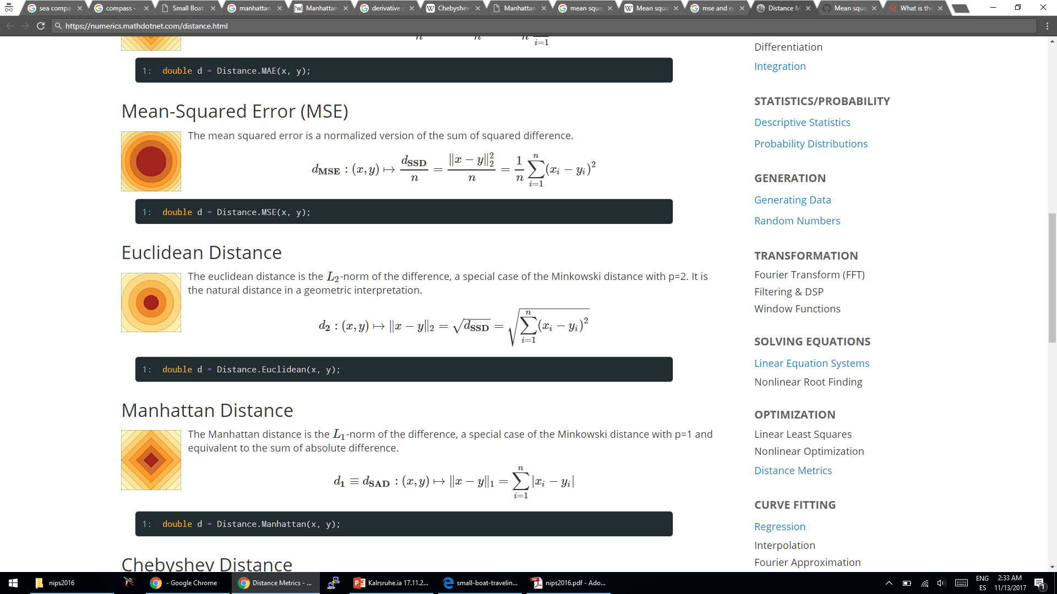

https://numerics.mathdotnet.com/distance.html

Slide 16
https://numerics.mathdotnet.com/distance.html

Slide 17
https://numerics.mathdotnet.com/distance.html

Slide 18
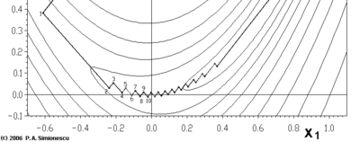
Notes:
Sense of Scale: Euclidean norms (or L1 norms in general) do not have sense of scale.
On High Dimensional Problems we have the curse of dimensionality.
MSE: Works well with convex problems with quadratic structure.
Each Dimension should have similar converging properties.

Slide 19
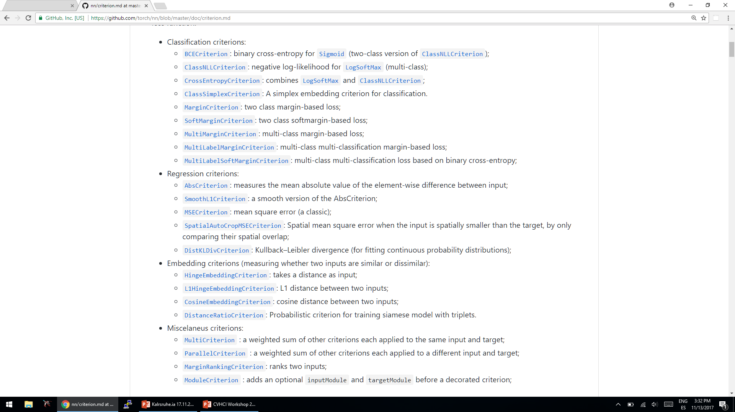
How do we choose the right loss/criterion?
From Torch7

Slide 20
How do we choose the right loss/criterion?
From Torch7

Slide 21
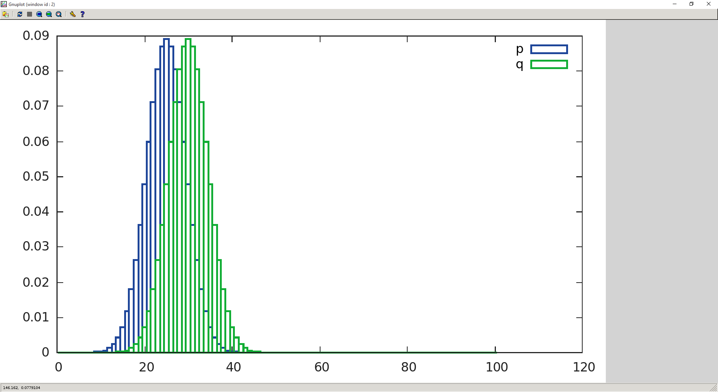
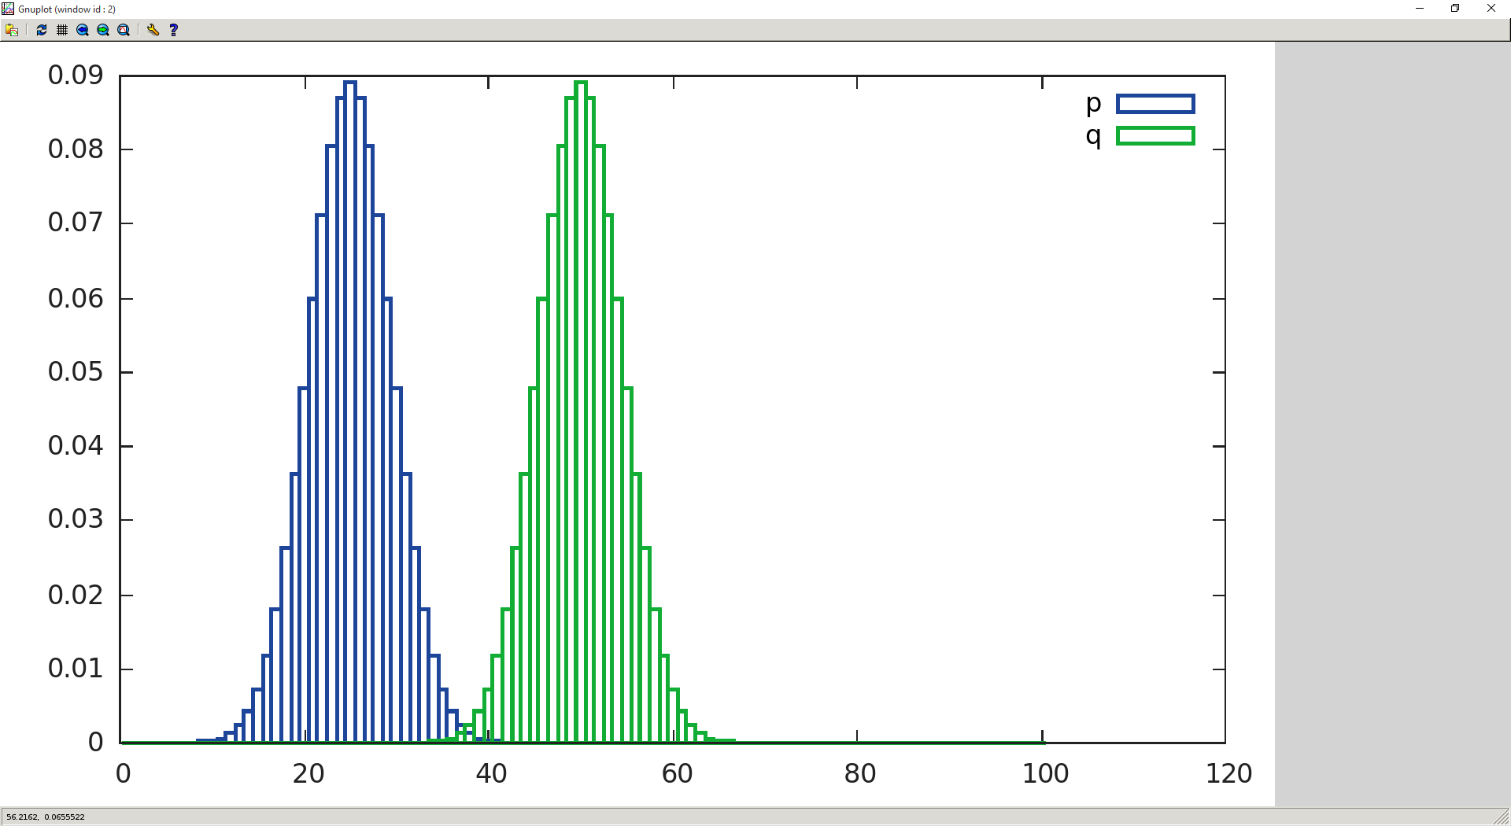
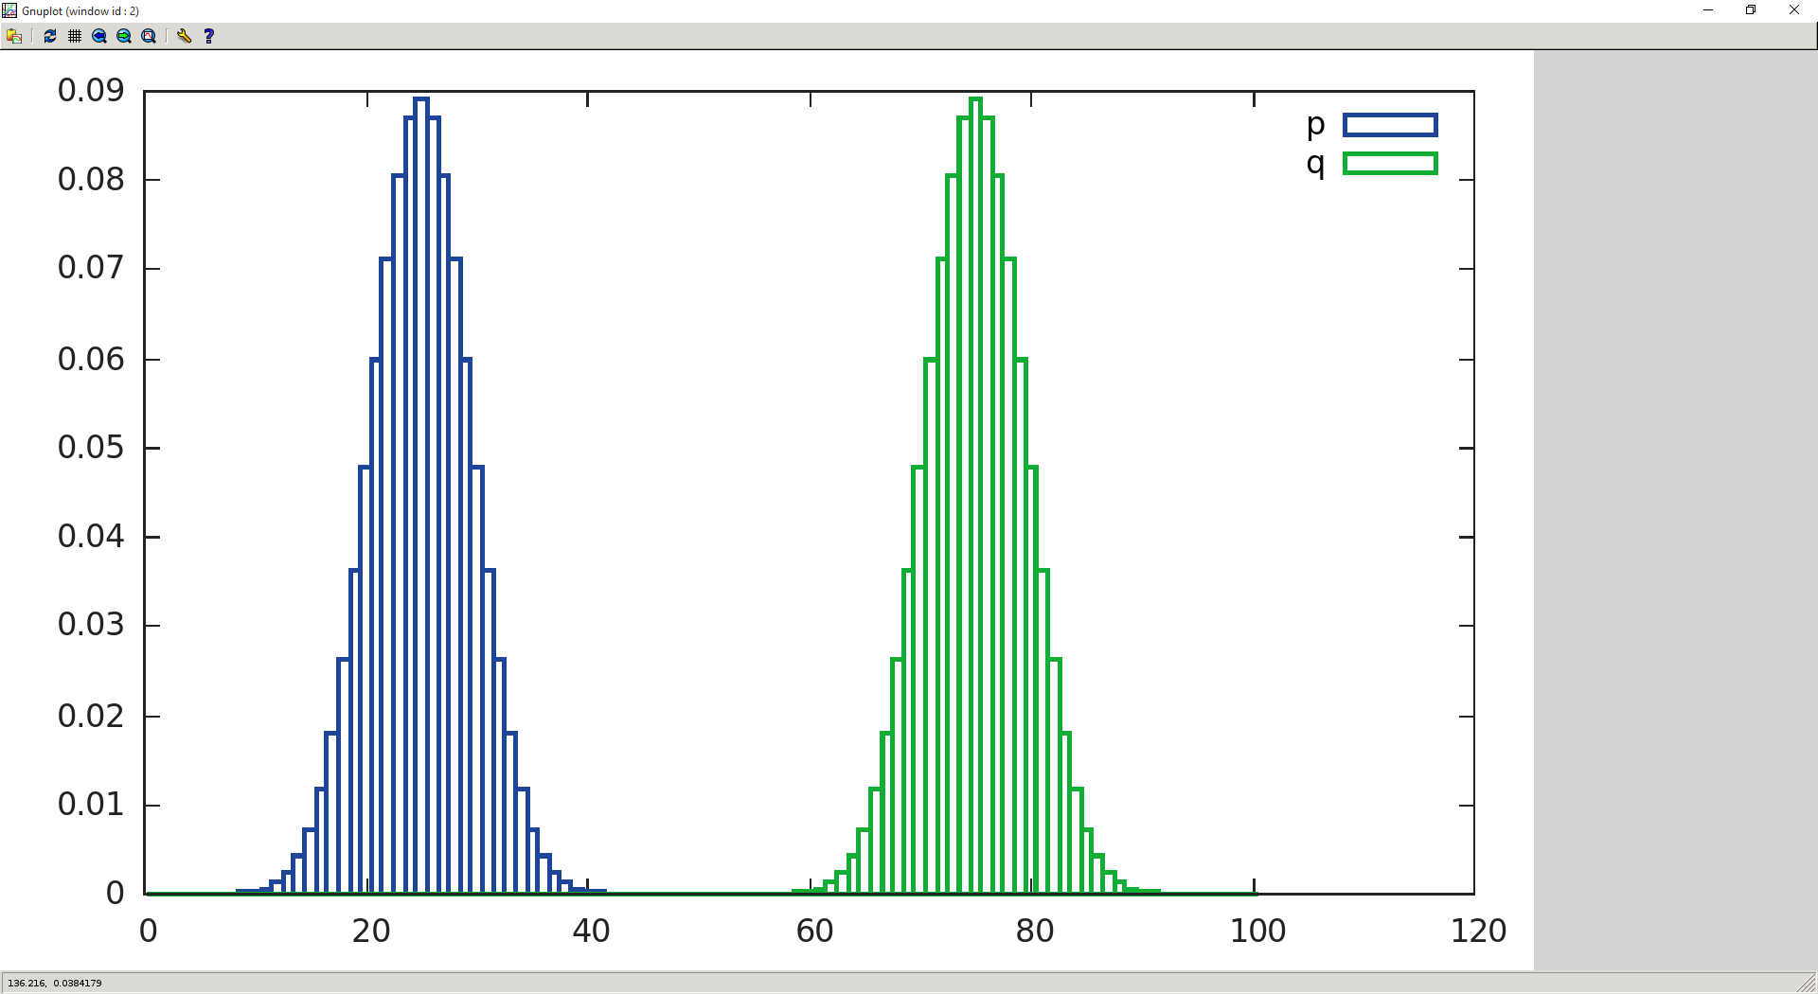
Which Loss would you choose for learning a 1D histogram?
MSE: 13.54
MSE: 50.44
MSE: 50.46
EMD: 5
EMD: 25
EMD: 50
Computer Science: Earth Mover’s Distance
Math: Wasserstein Distance
Statistics: Mallows Distance

Slide 22

The naming is not confusing at all #irony

Slide 23
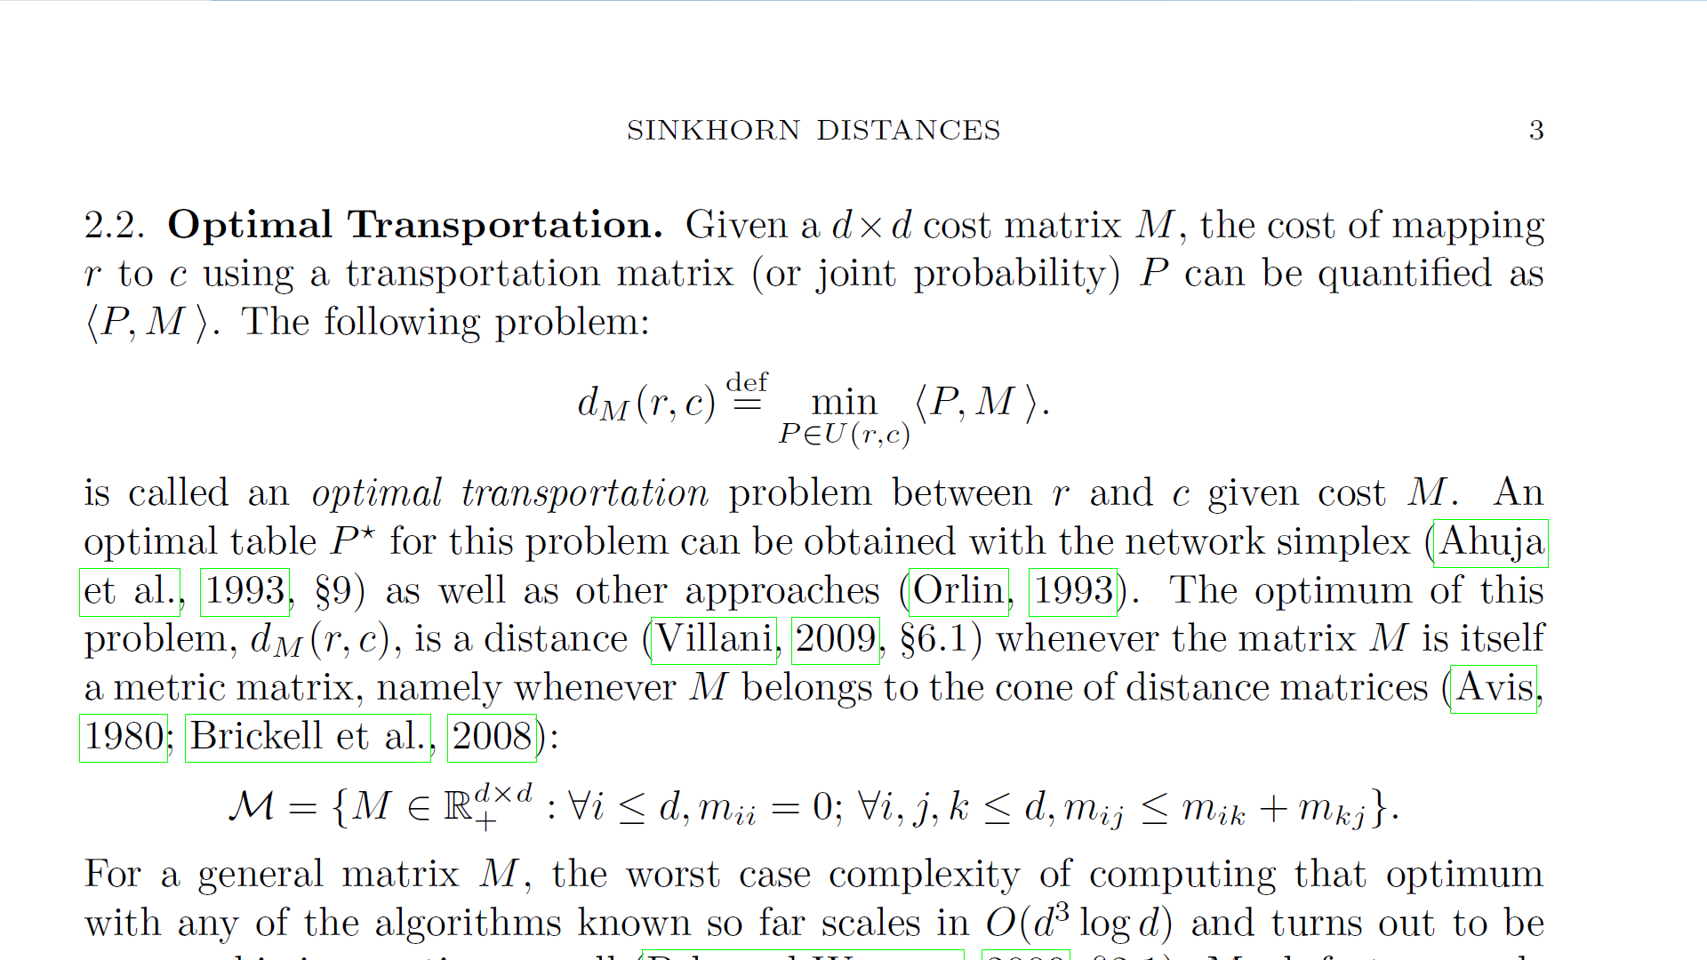
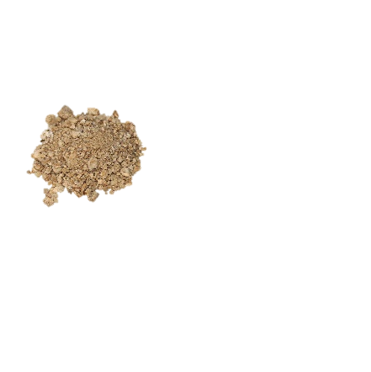
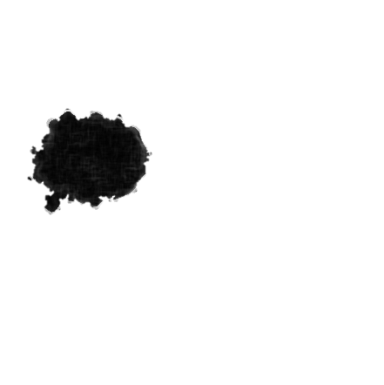
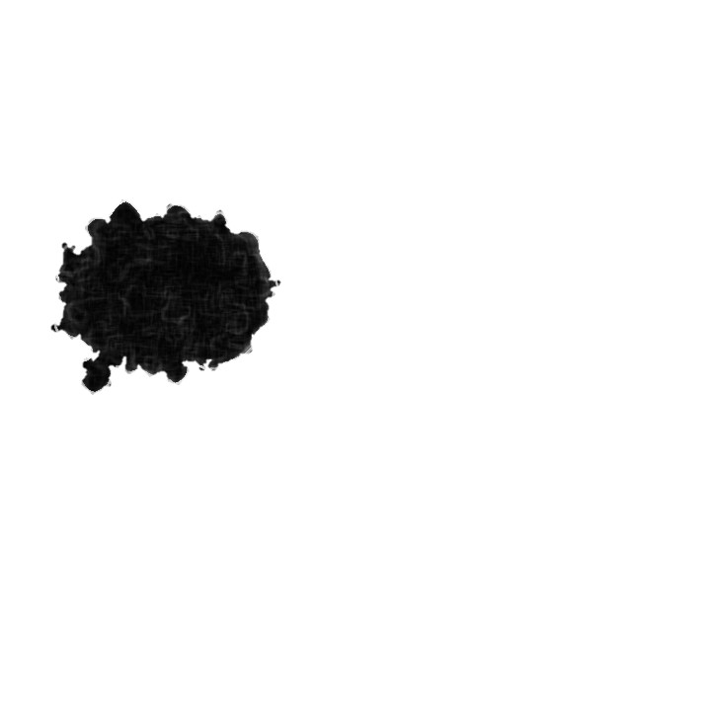
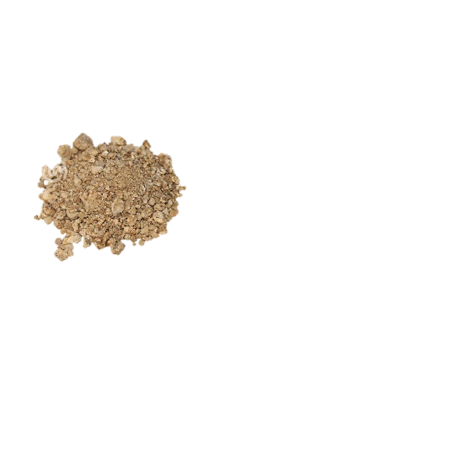
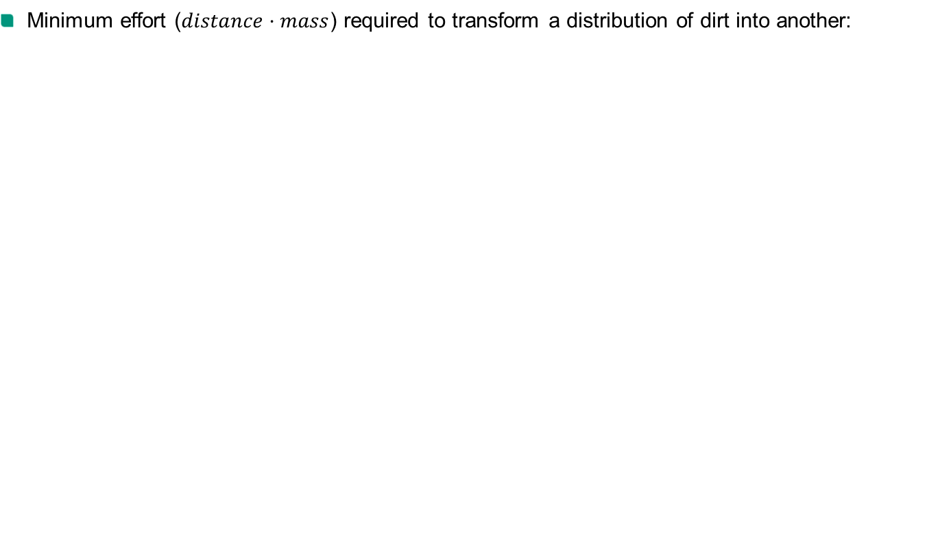
Earth Mover’s Distance
Minimum effort ($distance·mass$) required to transform a distribution of dirt into another:
Can we use it in DL?
No!
It is very slow to calculate!
"Sinkhorn distances: Lightspeed computation of optimal transport”, Cuturi, NIPS 2013

Slide 24
ALSO: SPECIAL CASE FOR HISTOGRAMS

Slide 25
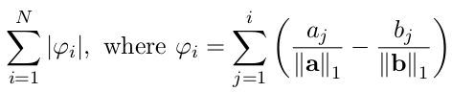
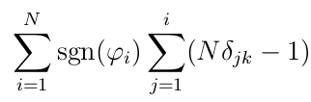
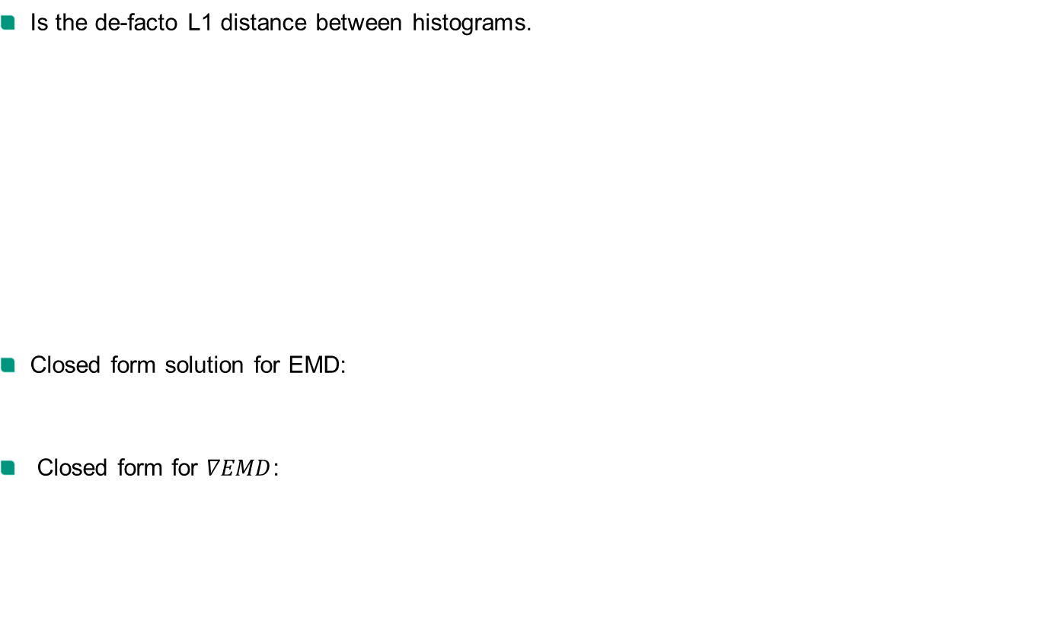
Earth Mover’s Distance
Is the de-facto L1 distance between histograms.
Closed form solution for EMD:
Closed form for $∇EMD$:
EMD: 5
EMD: 25
EMD: 50
“A Closed-form Gradient for the 1D Earth Mover’s Distance for Spectral Deep Learning on Biological Data”, Martinez, ICMLw 2016

Slide 26
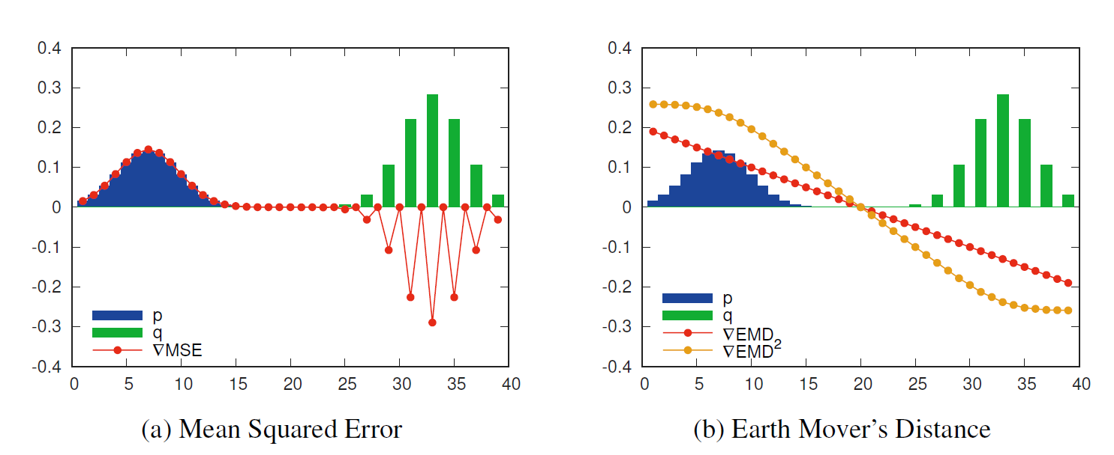
How does the Gradient Look Like?

Slide 27
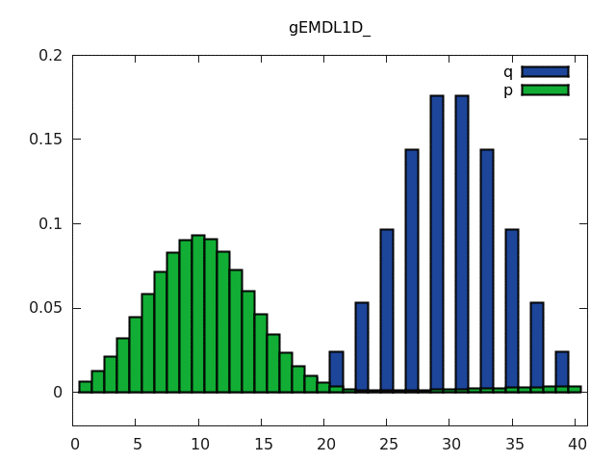
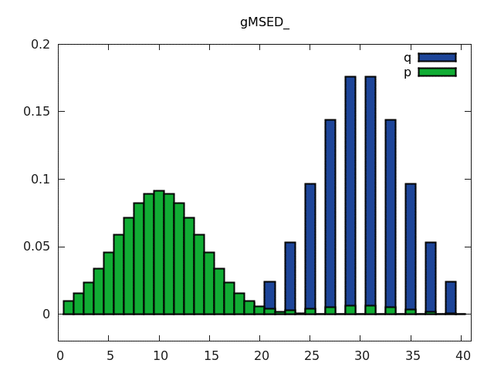


MSE vs Earth Mover’s Distance: Smoothness
EMD
MSE

Slide 28
BACK TO THE GENERAL FORM

Slide 29
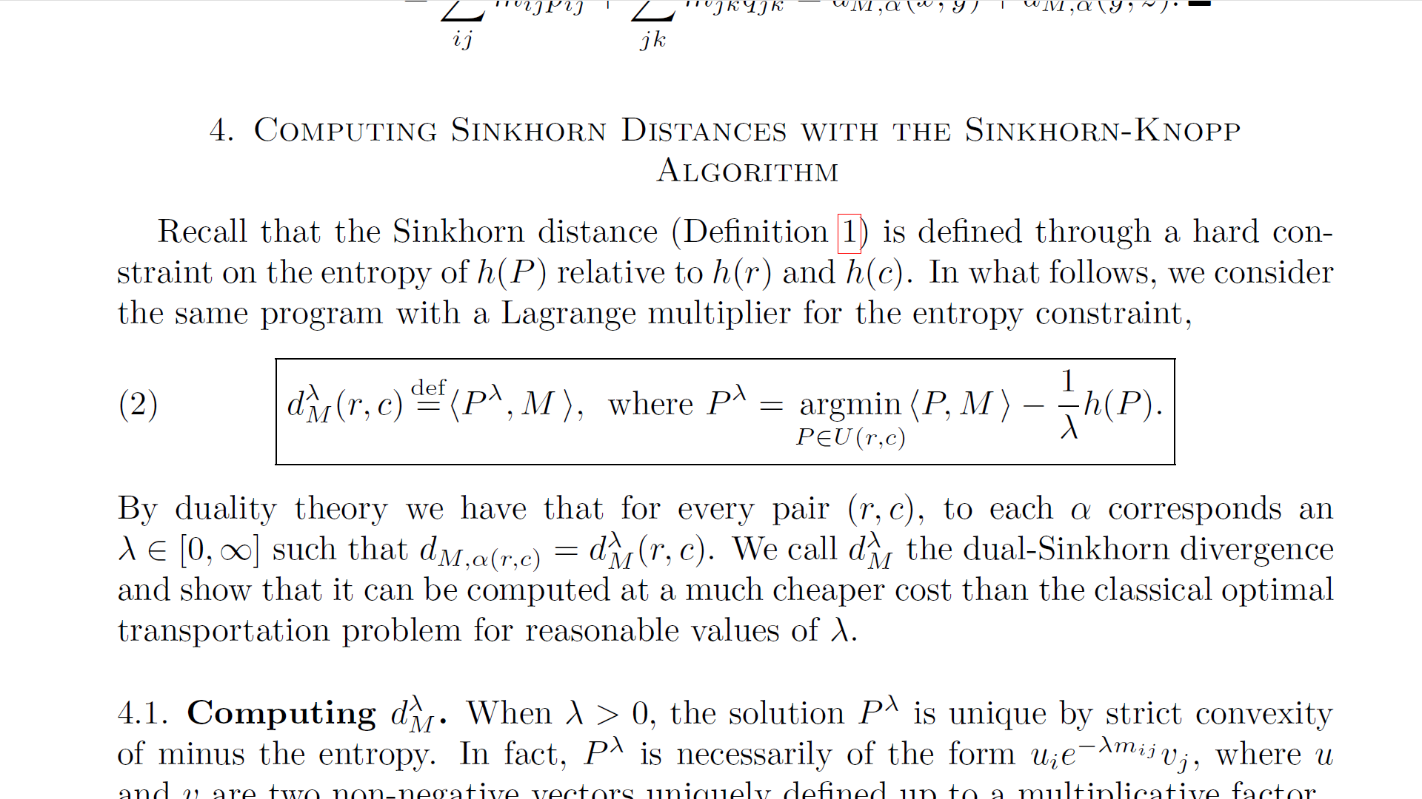
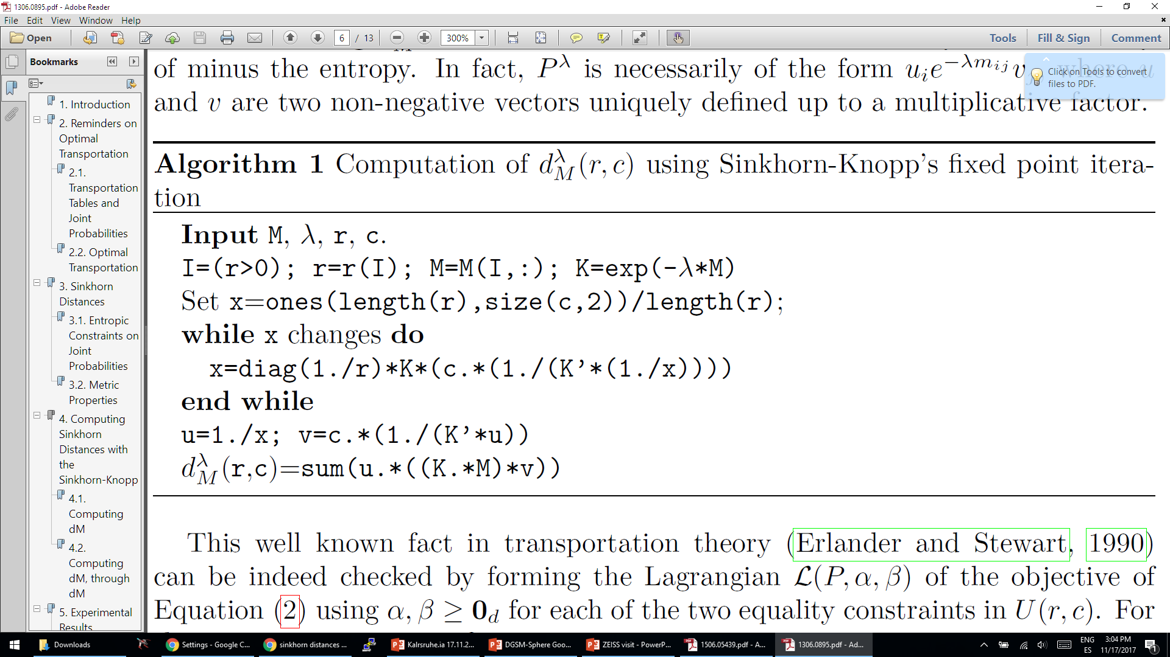
Sinkhorn Distance
Earth Mover’s Distance:
Sinkhorn:
IT IS FAST!
Can we use it in DL?
No!
We need a gradient, not a distance.
"Sinkhorn distances: Lightspeed computation of optimal transport”, Cuturi, NIPS 2013

Slide 30
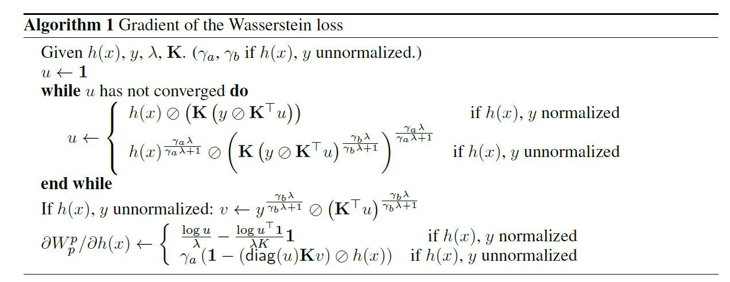
Learning with a Wasserstein (sic.) Loss
Implementations ready for Caffe and Julia.
"Learning with a Wasserstein Loss”, Frogner, NIPS 2015

Slide 31
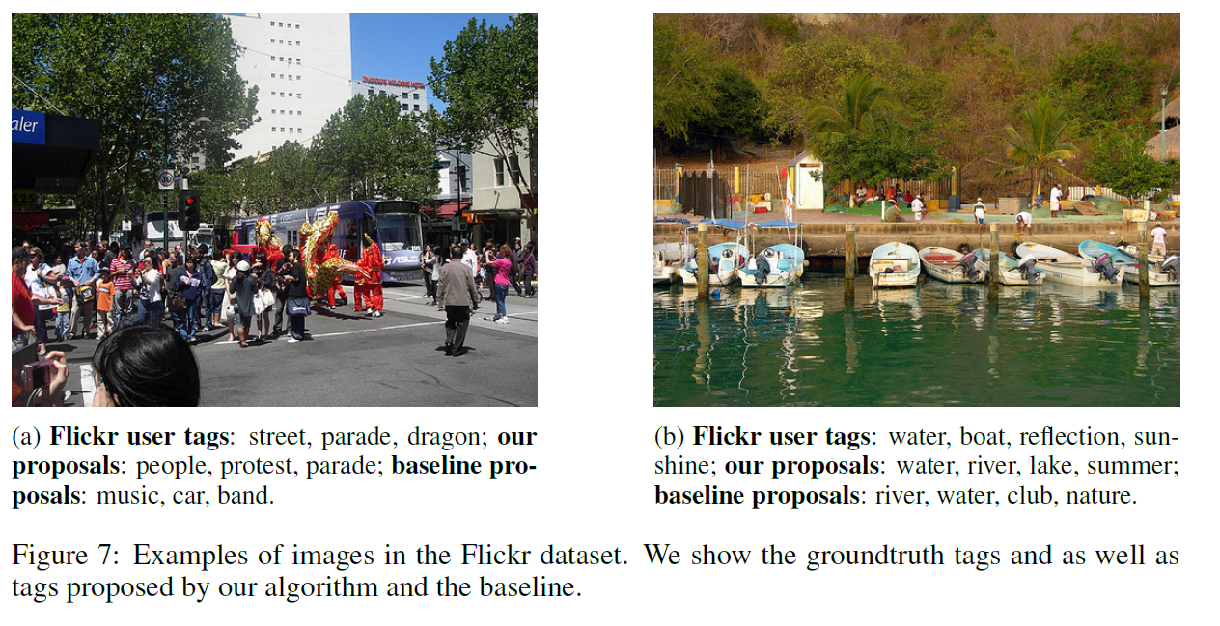
Learning with a Wasserstein (sic.) Loss
Task: Predict tags.
Inner metric: word2vec similarity between tags.
Results: worse AUC, better semantic similarity.
"Learning with a Wasserstein Loss”, Frogner, NIPS 2015

Slide 32
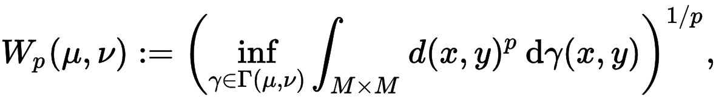
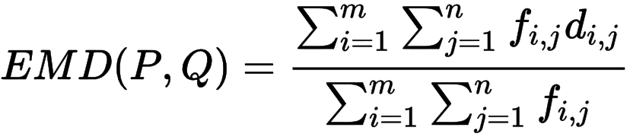
Names before Frogner’s paper:
Wasserstein metric: (continuous, analytic)
Earth Mover’s Distance: (discrete, slow)
Mallows Distance: no one cares.
Sinkhorn Distance: (discrete, fast, approximate)

Slide 33
Names after Frogner’s paper:
Wasserstein metric: -> Wasserstein Distance (continuous, analytic)
Earth Mover’s Distance: -> Wasserstein Distance (discrete, slow)
Mallows Distance: no one cares.
Sinkhorn Distance: ->Wasserstein Distance (discrete, fast, approximate)

Slide 34
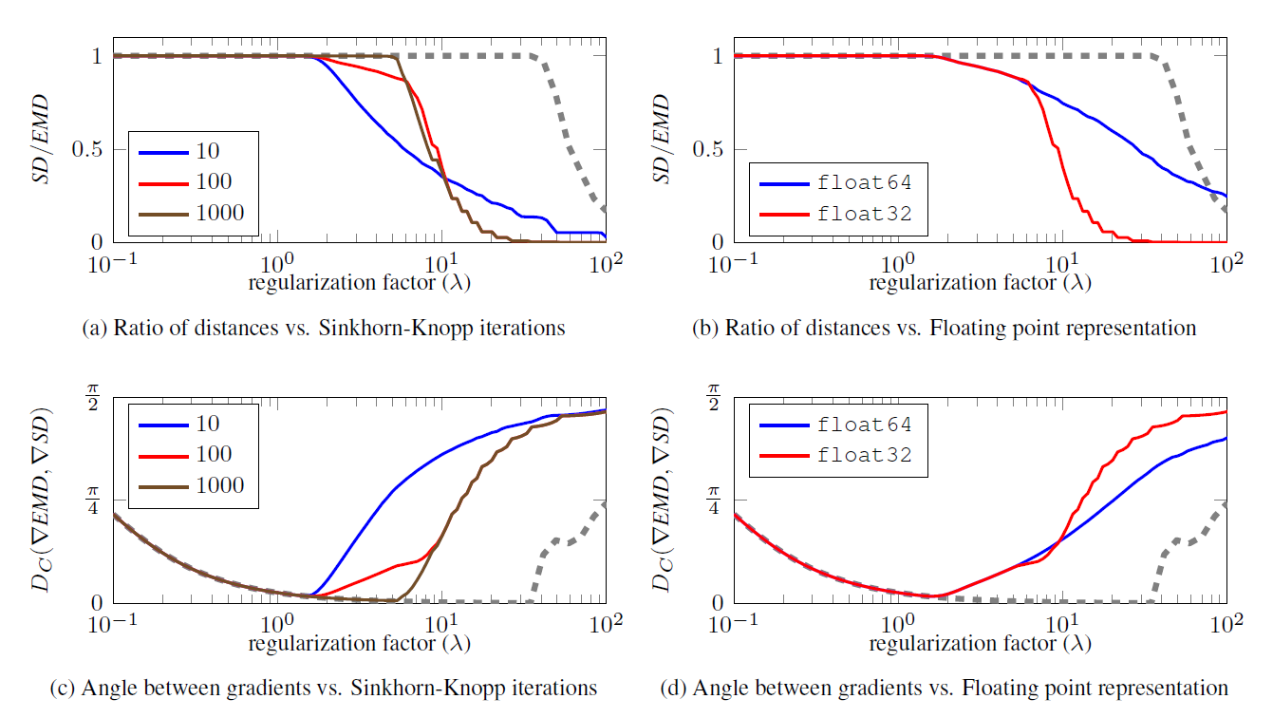
Problems of the Sinkhorn distance.
It is still not that fast.
EMD is a L1 distance (i.e., like Euclidean).
Sinkhorn can be numerically unstable, particularly on GPUs:
“Relaxed Earth Mover's Distances for Chain-and Tree-connected Spaces and their use as a Loss Function in Deep Learning”, Martinez, arxiv, 2016

Slide 35
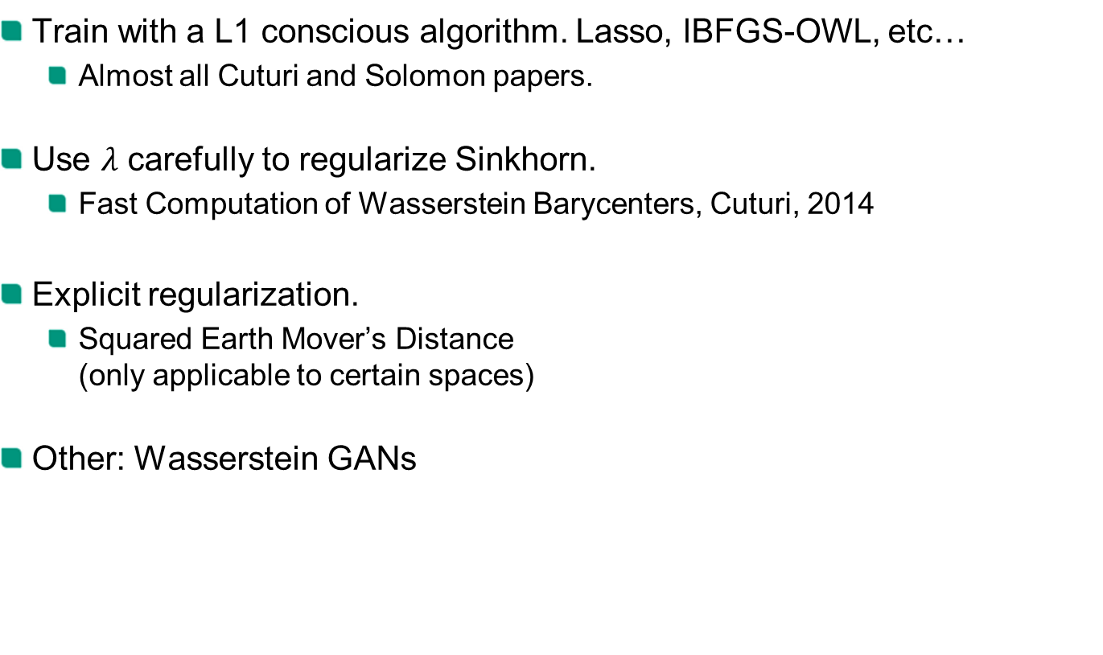
Possible solutions:
Train with a L1 conscious algorithm. Lasso, lBFGS-OWL, etc…
Almost all Cuturi and Solomon papers.
Use $λ$ carefully to regularize Sinkhorn.
Fast Computation of Wasserstein Barycenters, Cuturi, 2014
Explicit regularization.
Squared Earth Mover’s Distance (only applicable to certain spaces)
Other: Wasserstein GANs

Slide 36
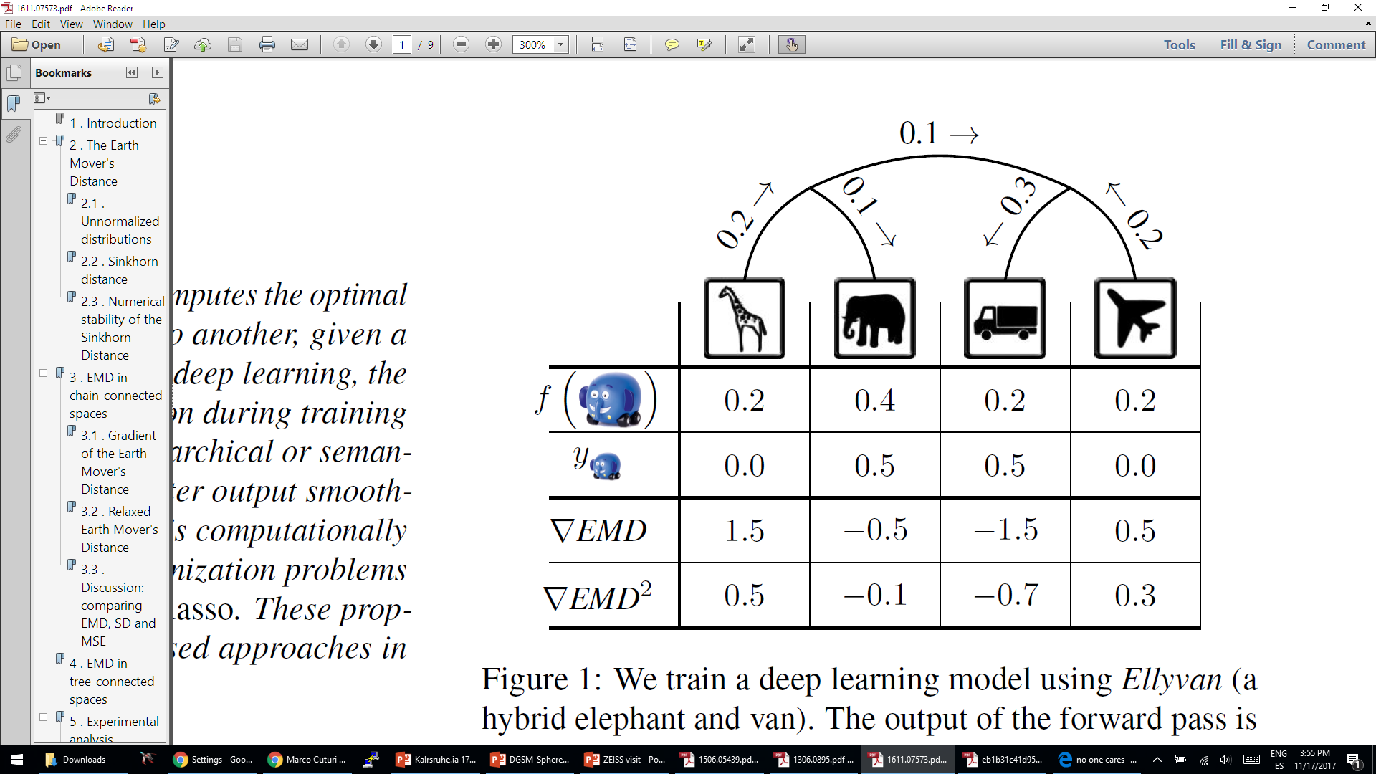
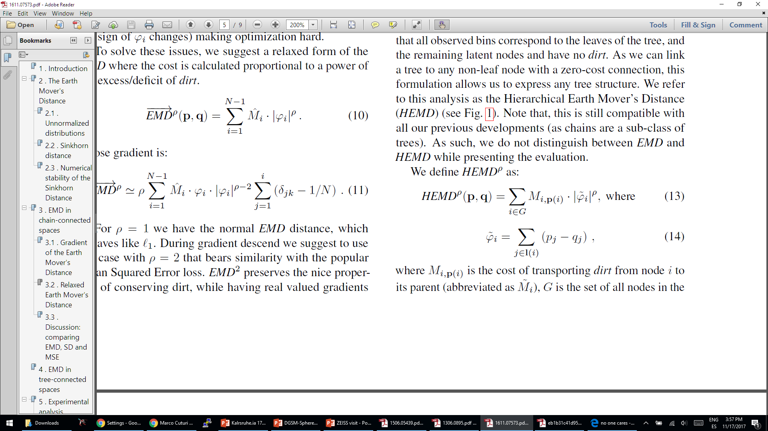
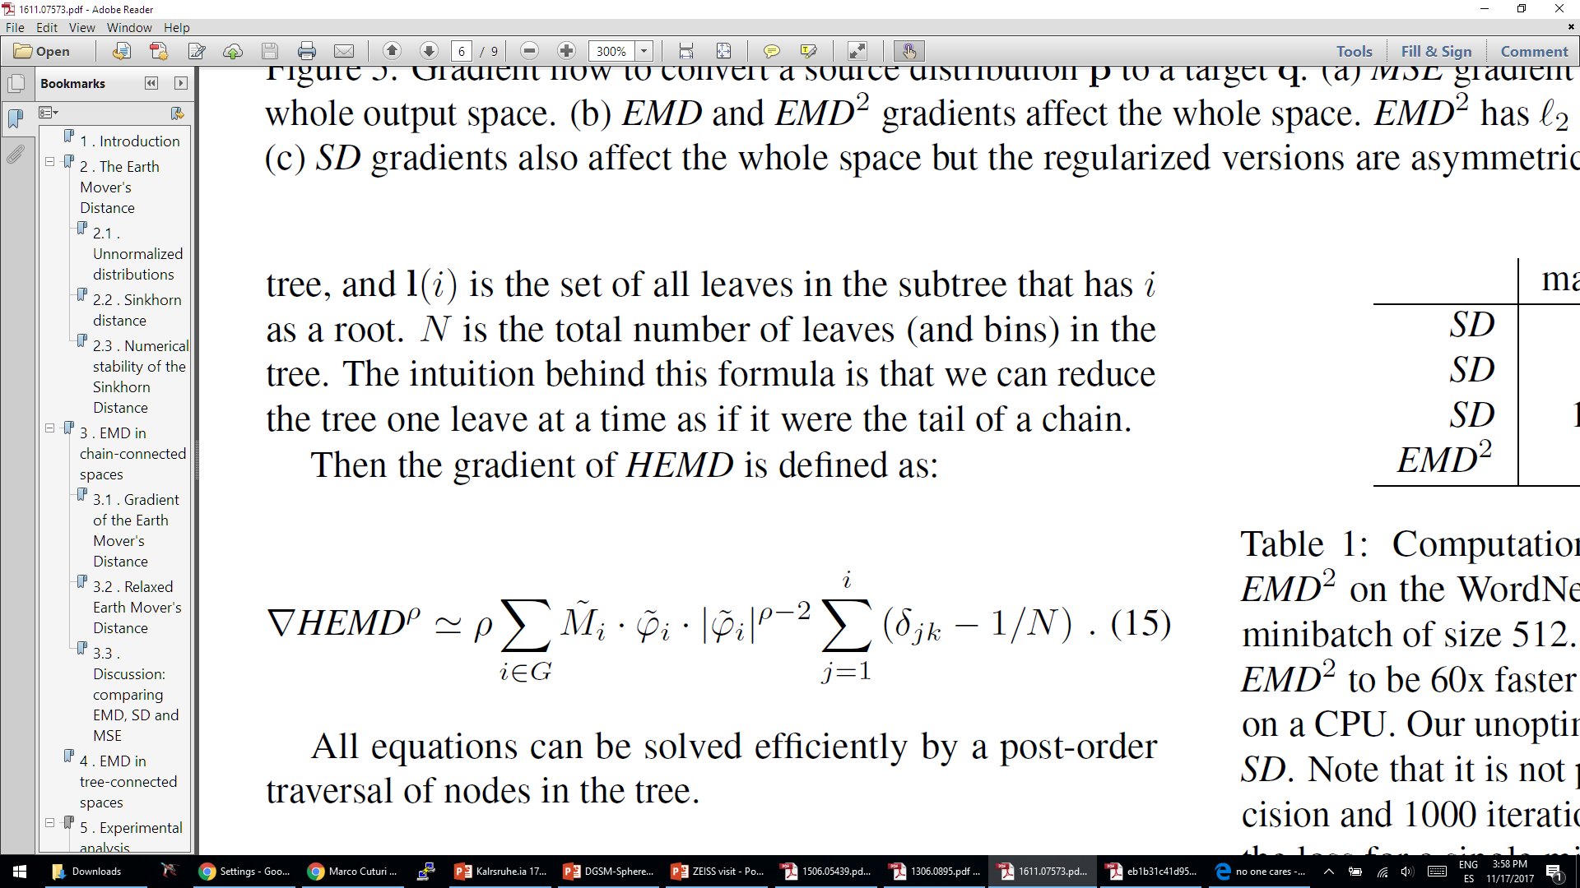
Relaxed Earth Mover’s Distance
“Relaxed Earth Mover's Distances for Chain-and Tree-connected Spaces and their use as a Loss Function in Deep Learning”, Martinez, arxiv, 2016

Slide 37
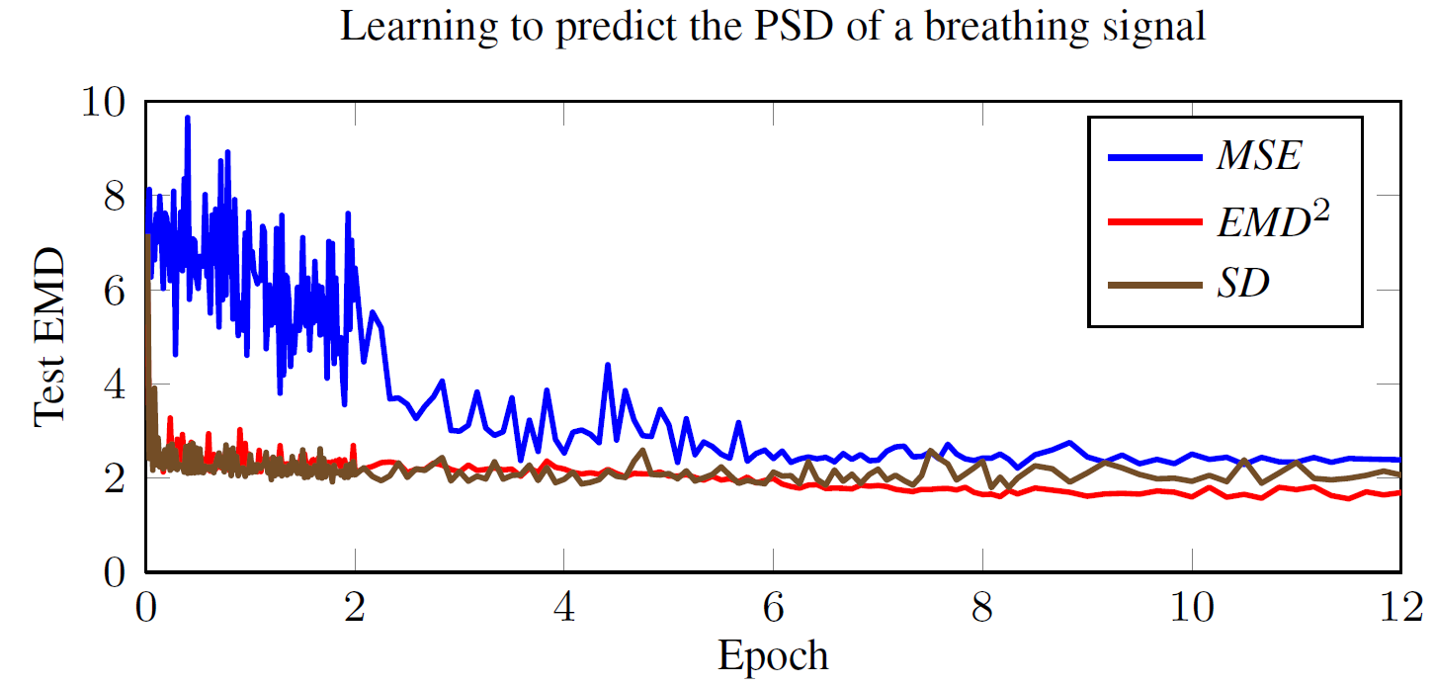
Example: Breathing Rate
“Relaxed Earth Mover's Distances for Chain-and Tree-connected Spaces and their use as a Loss Function in Deep Learning”, Martinez, arxiv, 2016

Slide 38


Example: ImageNet
“Relaxed Earth Mover's Distances for Chain-and Tree-connected Spaces and their use as a Loss Function in Deep Learning”, Martinez, arxiv, 2016

Slide 39
Conclusions:
Earth Mover’s Distance is a tricky Loss to use but:
It has become way more available recently.
It allows us to Embed a Metric from the Output Space.
It is Natural for Histogram Prediction / Probability Distributions, etc.
Resources:
Math: http://marcocuturi.net/SI.html
Deep Learning: http://cbcl.mit.edu/wasserstein/
Fancy but broken uses:
Wasserstein GAN
Improved Training of Wasserstein GANs
Improving the Improved Training of Wasserstein GANs

